Slide 1
DDOS ATTACK DETECTION AND MITIGATION USING STATISTICAL AND MACHINE LEARNING METHODS IN SDN
NAME: VARUN GOEL
REGISTERATION NO: 21MCA1099
GUIDE NAME : RAJAKUMAR ARUL

Slide 2
PROBLEM STATEMENT
“Can Software defined networking improve the detection and mitigation of DDOS attacks in a cloud environment”

Slide 3

GUIDE APPROVAL:

Slide 4
METHODOLOGY
Data Collection of the statistical features.
Normal traffic
Attack traffic
SVM will be using this dataset to train itself and to
Predict the traffic as normal or DDOS attack traffic.

Slide 5
Platform setup on with LINUX MINT 20.04 OS0
OpenFlow Protocol for SDN
Ryu controller – Python Based
DEVELOPMENT TOOLS

Slide 6
SIMULATION TOOLS
Mininet
Mininet is a software emulator for prototyping a large network on a single machine. Mininet can be used to quickly create a realistic virtual network running actual kernel, switch and software application code on a personal computer.
Hping3
hping is an open-source packet generator and analyzer for the TCP/IP protocol created by Salvatore Sanfilippo. It is one of the common tools used for security auditing and testing of firewalls and networks, and was used to exploit the idle scan scanning technique, and now implemented in the Nmap Security Scanner.
Iperf
Iperf is a tool for network performance measurement and tuning. It is a cross-platform tool that can produce standardized performance measurements for any network. Iperf has client and server functionality, and can create data streams to measure the throughput between the two ends in one or both directions.

Slide 7
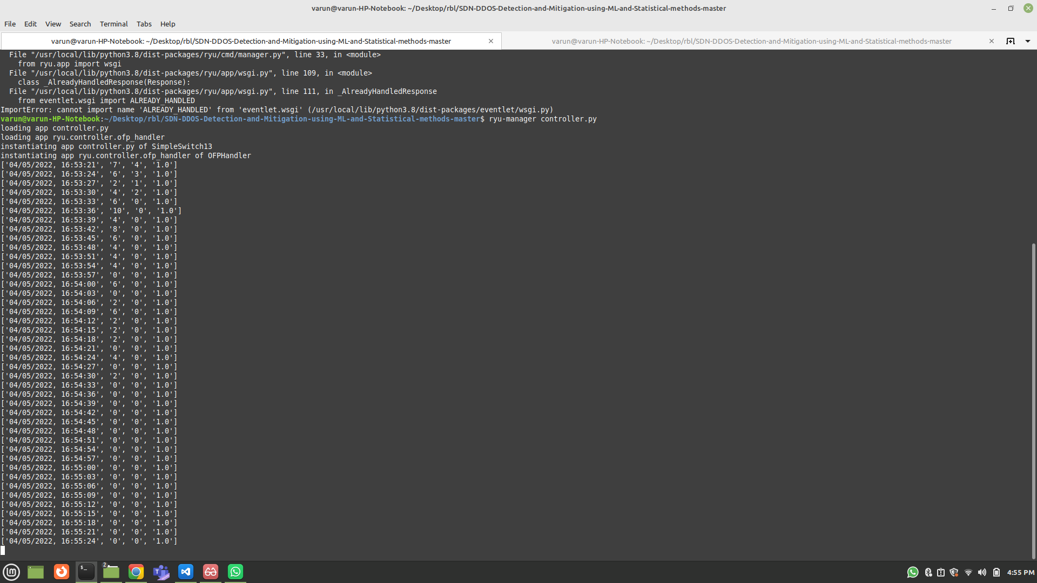
NORMAL TRAFFIC GENERATION

Slide 8
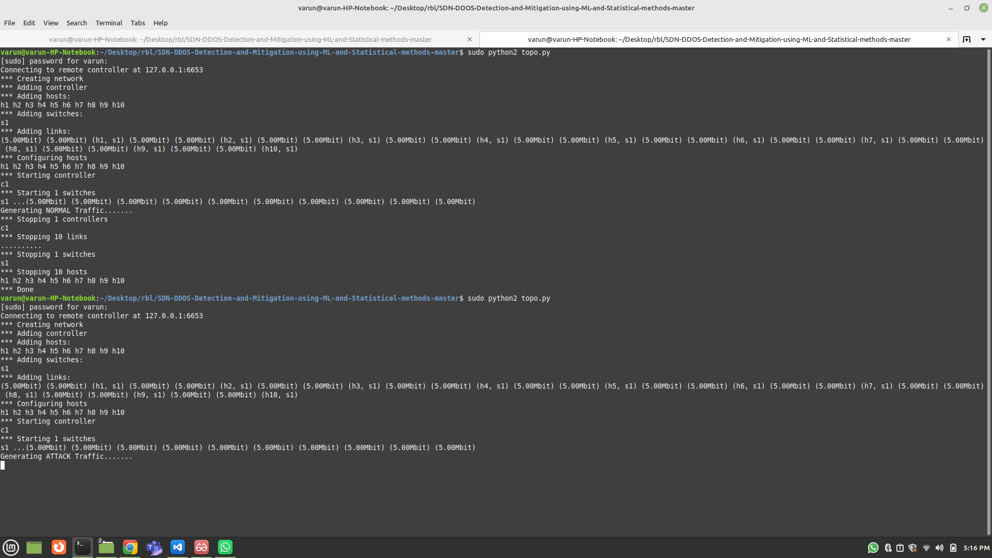
NORMAL TRAFFIC GENERATED

Slide 9
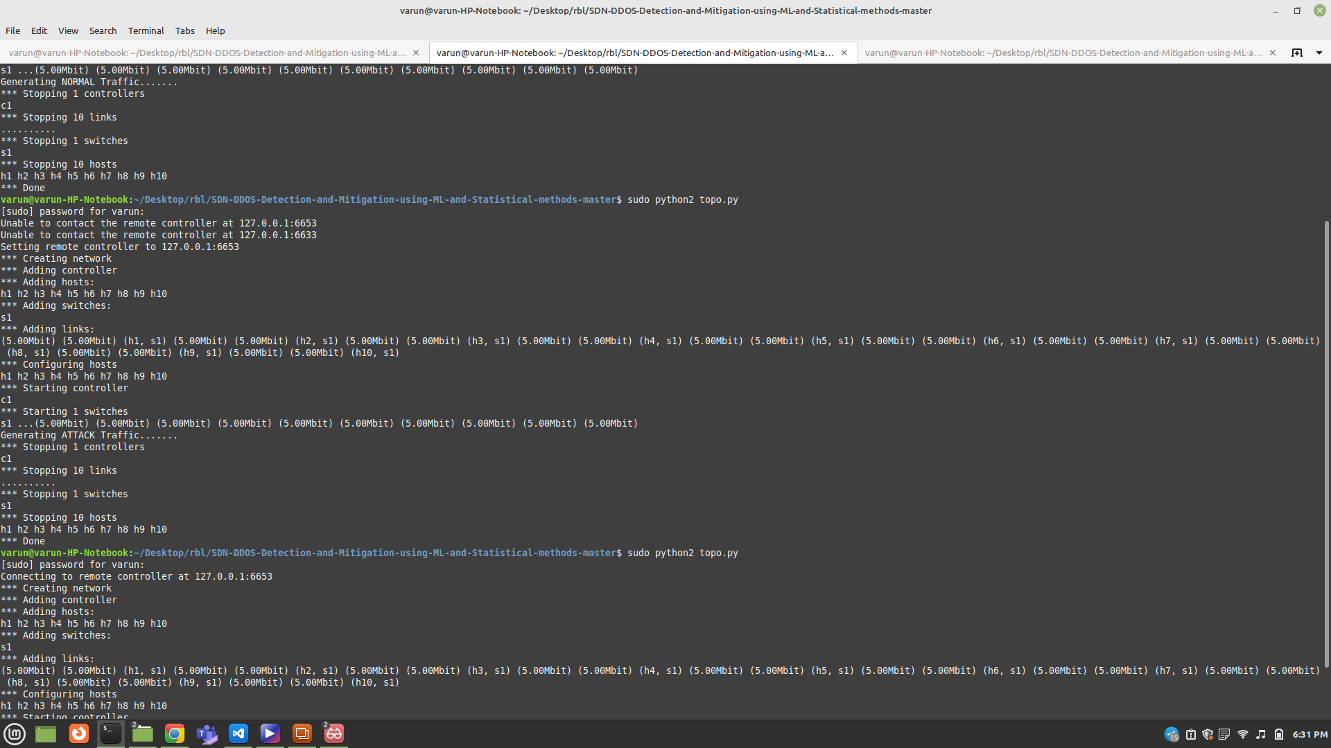
ATTACK TRAFFIC GENERATED

Slide 10
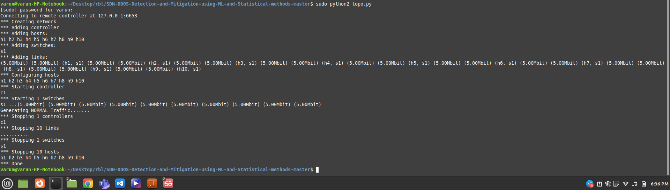
NORMAL TRAFFIC GENERATION

Slide 11
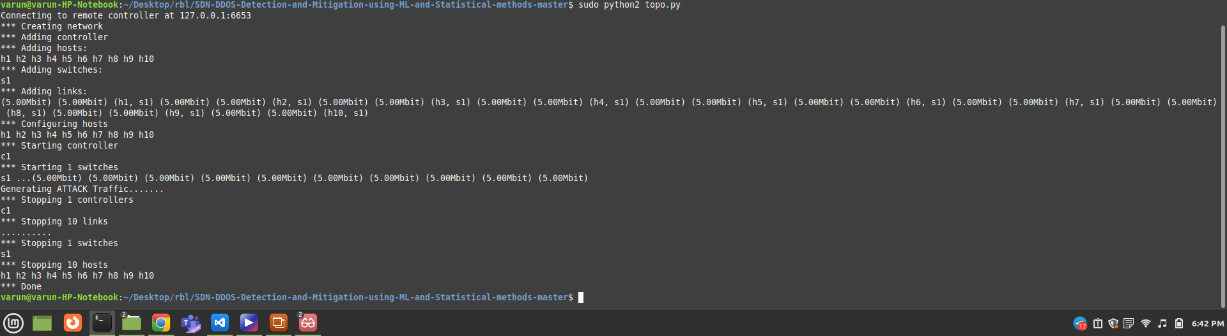
ATTACK TRAFFIC GENERATION

Slide 12
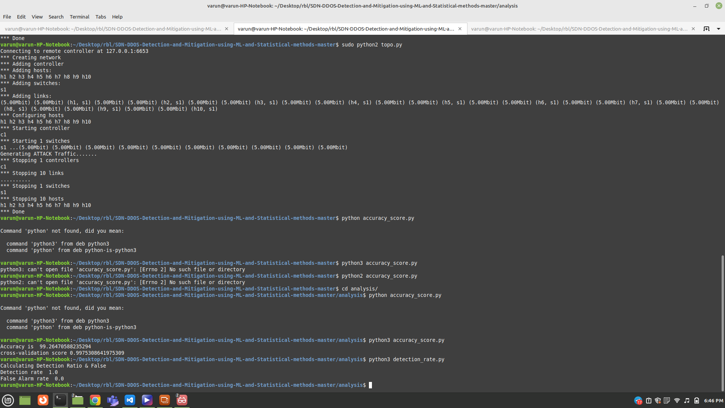
ACCURACY AND DETECTION RATE

Slide 13

THANK YOU

